Slide 1




VISUAL BASIC.NET

Slide 2

Overview of ADO.NET
ADO.NET provides consistent access to data sources such as Microsoft SQL Server, as well as data sources exposed through OLE DB and XML. Data-sharing consumer applications can use ADO.NET to connect to these data sources and retrieve, manipulate, and update data.

Slide 3
Overview of ADO.NET
ADO.NET cleanly factors data access from data manipulation into discrete components that can be used separately or in tandem. ADO.NET includes .NET Framework data providers for connecting to a database, executing commands, and retrieving results. Those results are either processed directly, or placed in an ADO.NET DataSet object in order to be exposed to the user in an ad-hoc manner, combined with data from multiple sources, or remoted between tiers.

Slide 4
Overview of ADO.NET
The ADO.NET DataSet object can also be used independently of a .NET Framework data provider to manage data local to the application or sourced from XML.
The ADO.NET classes are found in System.Data.dll, and are integrated with the XML classes found in System.Xml.dll. When compiling code that uses the System.Data namespace, reference both System.Data.dll and System.Xml.dll.

Slide 5
ADO.NET Architecture
Data processing has traditionally relied primarily on a connection-based, two-tier model. As data processing increasingly uses multi-tier architectures, programmers are switching to a disconnected approach to provide better scalability for their applications.

Slide 6
XML and ADO.NET
ADO.NET leverages the power of XML to provide disconnected access to data. ADO.NET was designed hand-in-hand with the XML classes in the .NET Framework — both are components of a single architecture.
ADO.NET and the XML classes in the .NET Framework converge in the DataSet object. The DataSet can be populated with data from an XML source, whether it is a file or an XML stream.

Slide 7
XML and ADO.NET
The DataSet can be written as World Wide Web Consortium (W3C) compliant XML, including its schema as XML Schema definition language (XSD) schema, regardless of the source of the data in the DataSet. Because the native serialization format of the DataSet is XML, it is an excellent medium for moving data between tiers making the DataSet an optimal choice for remoting data and schema context to and from an XML Web service.

Slide 8
ADO.NET Components
The ADO.NET components have been designed to factor data access from data manipulation. There are two central components of ADO.NET that accomplish this: the DataSet, and the .NET Framework data provider, which is a set of components including the Connection, Command, DataReader, and DataAdapter objects.

Slide 9
ADO.NET Components
The ADO.NET DataSet is the core component of the disconnected architecture of ADO.NET. The DataSet is explicitly designed for data access independent of any data source. As a result it can be used with multiple and differing data sources, used with XML data, or used to manage data local to the application. The DataSet contains a collection of one or more DataTable objects made up of rows and columns of data, as well as primary key, foreign key, constraint, and relation information about the data in the DataTable objects.

Slide 10
ADO.NET Components
The other core element of the ADO.NET architecture is the .NET Framework data provider, whose components are explicitly designed for data manipulation and fast, forward-only, read-only access to data. The Connection object provides connectivity to a data source. The Command object enables access to database commands to return data, modify data, run stored procedures, and send or retrieve parameter information.

Slide 11
ADO.NET Components
The DataReader provides a high-performance stream of data from the data source. Finally, the DataAdapter provides the bridge between the DataSet object and the data source. The DataAdapter uses Command objects to execute SQL commands at the data source to both load the DataSet with data, and reconcile changes made to the data in the DataSet back to the data source.

Slide 12
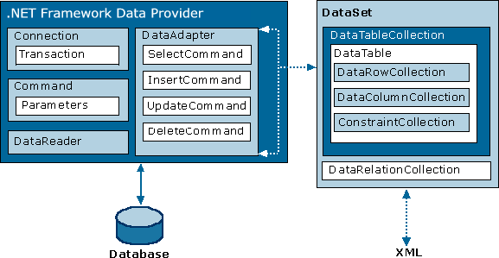
ADO.NET Components

Slide 13
Populating Datasets
A dataset is a container; therefore, you need to fill it with data. When you populate a dataset, various events are raised, constraint checking applies, and so on.
Call the Fill method of a data adapter. This causes the adapter to execute an SQL statement or stored procedure and fill the results into a table in the dataset. If the dataset contains multiple tables, you probably have separate data adapters for each table, and must therefore call each adapter's Fill method separately.

Slide 14
Record Position and Navigation in Datasets
In a Windows application, navigation through records in a data source is managed by the data-binding layer. The BindingSource object associated with a table or view in a dataset supports a Position property. The Position property is used by the data-binding mechanism to make sure that individual controls all read and write data to the same record.

Slide 15
Record Position and Navigation in Datasets
Private Sub Button1_Click(ByVal sender As System.Object, ByVal e As System.EventArgs) Handles Button1.Click
If Me.EmpBindingSource.Position < Me.EmpBindingSource.Count - 1 Then
Me.EmpBindingSource.MoveNext()
End If
End Sub

Slide 16
Record Position and Navigation in Datasets
Private Sub Button2_Click(ByVal sender As System.Object, ByVal e As System.EventArgs) Handles Button2.Click
If Me.EmpBindingSource.Position > 0 Then
Me.EmpBindingSource.MovePrevious()
End If
End Sub

Slide 17
Record Position and Navigation in Datasets
Private Sub Button3_Click(ByVal sender As System.Object, ByVal e As System.EventArgs) Handles Button3.Click
Me.EmpBindingSource.MoveFirst()
End Sub
Private Sub Button4_Click(ByVal sender As System.Object, ByVal e As System.EventArgs) Handles Button4.Click
Me.EmpBindingSource.MoveLast()
End Sub

